Slide 1
Deanery Revitalisation Consultation
Master Slides

Slide 2
Overview of this presentation
We have pulled core facts and key illustrations from the webpages and the consultation feedback form to enable you as a group to discuss this process. The weblinks are provided if you need a quick recap.
We would strongly recommend that your members read the consultation document before you meet as what is presented here is a summary only.
Focus on the key issues that affect you as a group, e.g., Why, Where and Who. (You can skip any section on the feedback form if you want).
Individuals who wish to consider all of the details are encouraged to also complete a separate consultation form.
Please use as many or as few of these slides as you need to support your discussions.

Slide 3
Aims
To create opportunities to discuss the Deanery Revitalisation consultation.
To consider questions that link to:
  Why are we revitalising our Deaneries?
  What will leadership look like?
  Where will the new Areas be?
  Who goes into which Area?
  When will this all happen?
To provide an opportunity to submit a collective response.

Slide 4
Why https://www.chesterdiocese.org/content/why
Diverse Diocese
“Speaking the gospel with a local accent”
Local discernment and action
We need local solutions to shape mission and ministry
We have some of the most and least deprived parishes in the country
World has Changed
Our discerned Strategic Priorities are designed to address this
SP1: New Christian Communities
SP2: New Collaborative Partnerships
SP3: New Leadership Development
Deaneries are best placed
To spot where God is at work and join in
Encourage New Christian Communities
Spot and support Collaborative Partnership
Identify and release leaders for the future

Slide 5
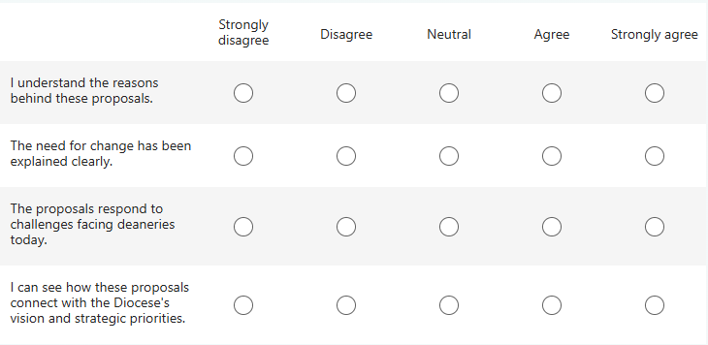
Why - Questions from the consultation
To what extent do you agree with the following statements?

Slide 6
Why - Questions from the consultation
What are your reflections on the reasons for change?

Slide 7
What https://www.chesterdiocese.org/content/what
Proposed Leadership Team
Area Dean – appointed by the Bishop
Area Lay Chair – elected by Deanery Synod
Assistant Area Dean – appointed by the Bishop
Additional members who are lay or ordained
Support for the Deanery Team
Transition accompanier: help and training
Increased Archdeacon support
£10k a year in transition funding per Area
Potential access to project funding
Role Descriptions
Every role - existing or new - will have a clear Role Description, so people know their responsibilities, can be selected fairly, and receive the right training.

Slide 8
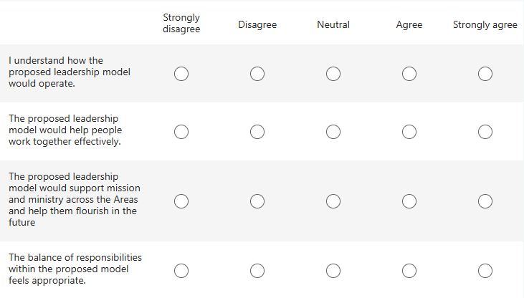
What - Questions from the consultation
Please rate the following aspects of the proposed model

Slide 9
What - Questions from the consultation
What are your reflections on the proposed leadership model?
You may wish to comment on opportunities, concerns, aspects of the current model that should be retained, or anything you feel may have been overlooked.
What are your thoughts and reactions to the proposed support for the suggested Area leadership team?
What are your thoughts and reactions to the suggested role descriptions for key roles in the proposed leadership model?

Slide 10
Where https://www.chesterdiocese.org/content/where
Reducing the Deaneries
Reduction from 18 to 13 New Areas (See the map on the next slide)
Many possible configurations were proposed ranging from 8 to 14
Configuring the New Areas
Criteria used included: comparable parish numbers, population, land size, Index of Multiple Deprivation
Local Authority boundaries were also considered
The two Archdeaconry boundaries are intact
New Area Names
Every existing Deanery to be changed in some way
CODENAMES used during initial discussions
New names proposed linked to Geographical location (see the separate slide)

Slide 11
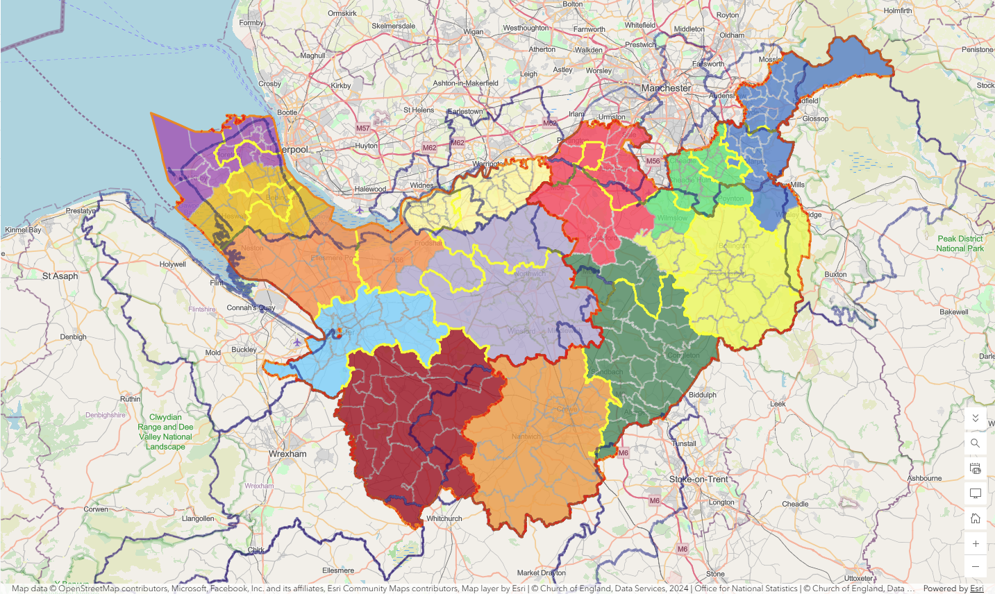
13 renewed Deaneries
7 / 6 Split
NECTARINE
MANGO
BADGER
FOX
DRAGONFRUIT
DEER
ROBIN
SQUIRREL
KIWI
OTTER
PAPAYA
HEDGEHOG
Archdeaconry Boundary
Existing Deanery Boundary
LA Boundary
GUAVA

Slide 12
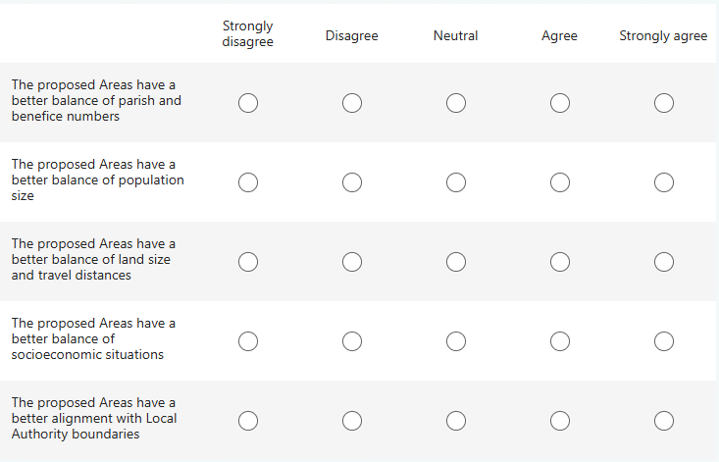
Where - Questions from the consultation
To what extent do you agree with he following?

Slide 13
Where - Questions from the consultation
Please share any comments on the proposed Area groupings.
  Localities or communities that should remain together;
  Localities or communities that should be grouped differently;
  Any proposed groupings that should be reconsidered; and
  Any local factors, relationships or mission opportunities that should be taken into account.
Focus on the way the different population centres in our diocese relate to each other.
We will ask more detailed questions about the impact on your own parish in the next section.

Slide 14
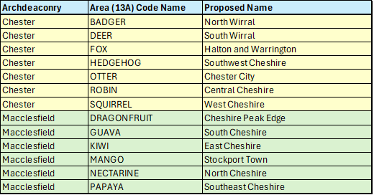
Proposed new area names

Slide 15
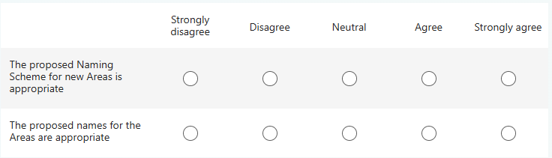
Where - Questions from the consultation
To what extent do you agree with he following?

Slide 16
Where - Questions from the consultation
Do you have any comments or suggestions regarding names for the new Areas?

Slide 17
Who https://www.chesterdiocese.org/content/who
Which Area will we be part of?
Multi-parish benefices and shared-clergy arrangements stay together
Who will we be with?
A searchable online table of all 262 parishes showing their current Deanery and proposed new Area
An interactive online map so you can see where your own parish sits, who you stay with, who joins and who leaves
How will we continue to be represented?
Existing Deanery Synod reps will continue to represent you in a new Area Deanery Synod
We need your help to make sure local collaboration, and shared missional contexts are not impacted
Diocesan Synod representation will change but we believe it is possible to generate identical representation under the new Areas as under the existing Deaneries

Slide 18
Own Area Map
Click on your Deanery name below to see your map.
On the map slide click on the navy-blue box to return to this page
Birkenhead
Bowdon
Chadkirk
Cheadle
Chester
Congleton
Frodsham
Great Budworth
Knutsford
Macclesfield
Malpas
Middlewich
Mottram
Nantwich
Stockport
Wallasey
Wirral North
Wirral South

Slide 19
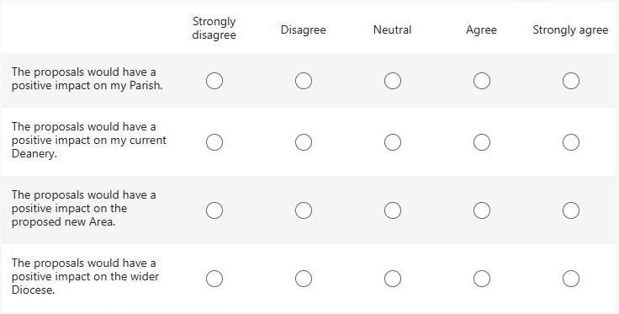
Who - Questions from the consultation
To what extent do you agree with he following?

Slide 20
Who - Questions from the consultation
What opportunities and challenges do you think these proposals may create for your Parish, Area, or the wider Diocese?

Slide 21
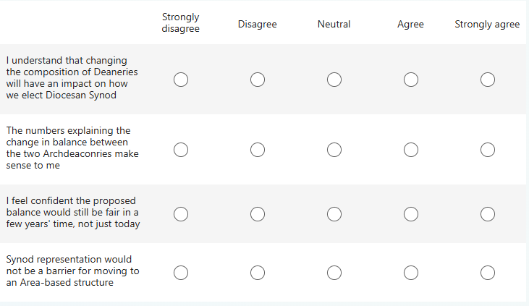
Who - Questions from the consultation
To what extent do you agree with he following , about the proposed representation of new areas at Diocesan Synod?

Slide 22
Who - Questions from the consultation
What are your comments/observations on representation for the proposed new Areas?

Slide 23
When https://www.chesterdiocese.org/content/when
Phase 1 Consultation
Feedback → Bishop Mark and his senior team.
Options: move to phase 2 or pause.
Phase 4 Transition
A few Areas will pilot the process in 2027, working with a Transition Accompanier to define the leadership structure, agree Role Descriptions and appoint permanent roles.
Phase 5 Implementation
New Area Leadership Teams start operating
Pilot evaluation → rolling out to remaining Areas during 2028 and 2029.
Phase 2 Bishop’s Pastoral Order
Phase 3 Interim arrangements
Proposed timeline
The legal document is signed by 31 Oct 2026
New arrangements start on 1 Nov 2026.
Interim arrangements to keep things running as they are.
Interim Area Dean, Interim Assistant Area Dean and Interim Area Lay Chair, carrying on the existing roles but for the new Area boundaries

Slide 24
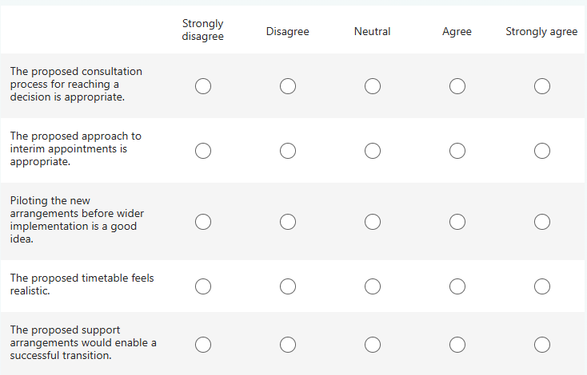
When - Questions from the consultation
To what extent do you agree with the following?

Slide 25
When - Questions from the consultation
What are your thoughts on the timeline or speed for this consultation and making the decision on these proposals?
What are your thoughts on the suggested timeline for the transition to the proposed Area model, once a decision is made?
What additional support, resources or practical steps would help make the transition successful?

Slide 26
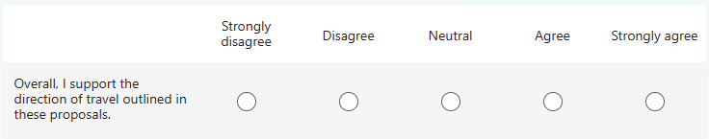
Final section: Final thoughts
Taking everything into account, to what extent do you agree with the following statement?

Slide 27
Final section: Final thoughts
Is there anything else you would like to tell us about the proposals for deanery restructuring?
This could include any opportunities, concerns, local considerations or suggestions that you have not already mentioned.
Are there any examples of effective collaboration, ministry or deanery life that you would encourage us to build upon as these proposals are developed?

Slide 28
End of presentation

Slide 29
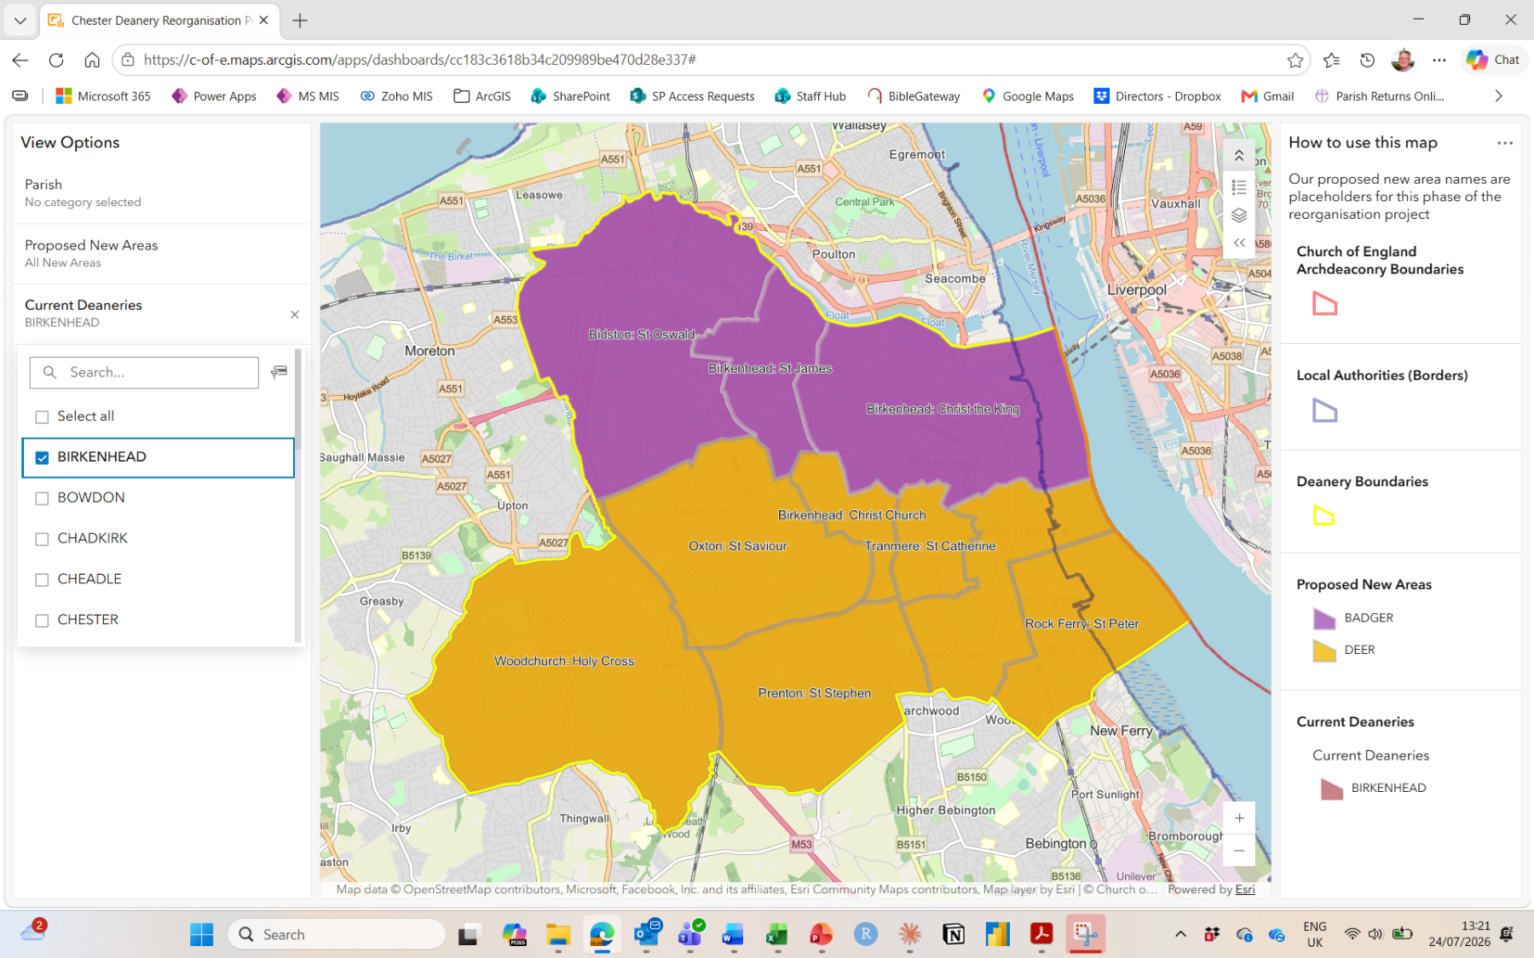
BIRKENHEAD:
New Areas:
3 to BADGER
7 to DEER
Click here to return to previous slide

Slide 30
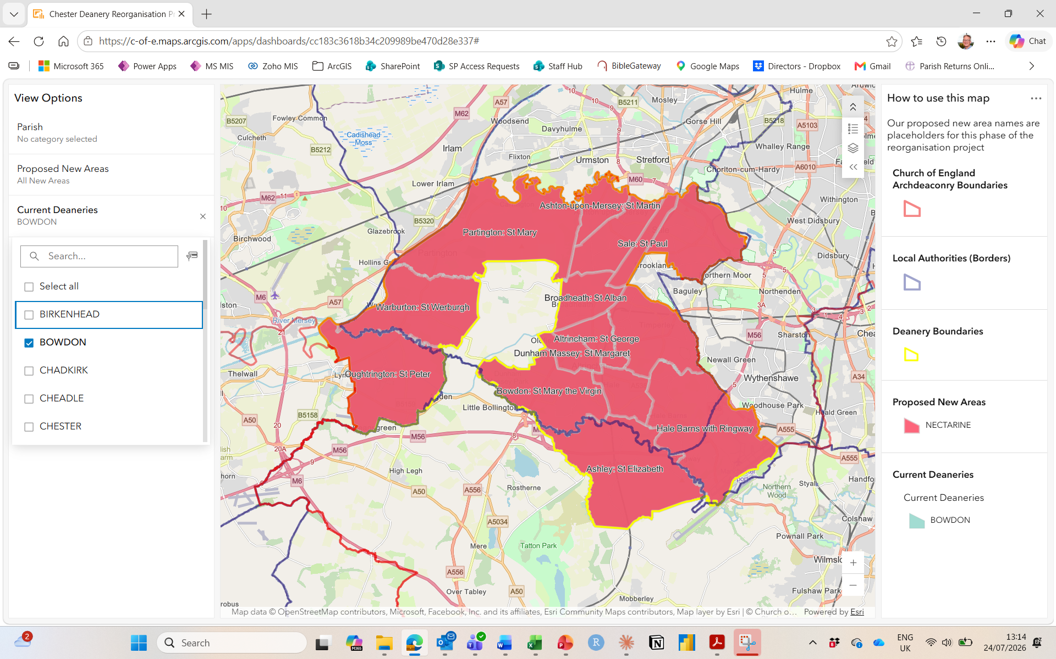
BOWDON:
New Areas:
All to NECTARINE
Click here to return to previous slide

Slide 31
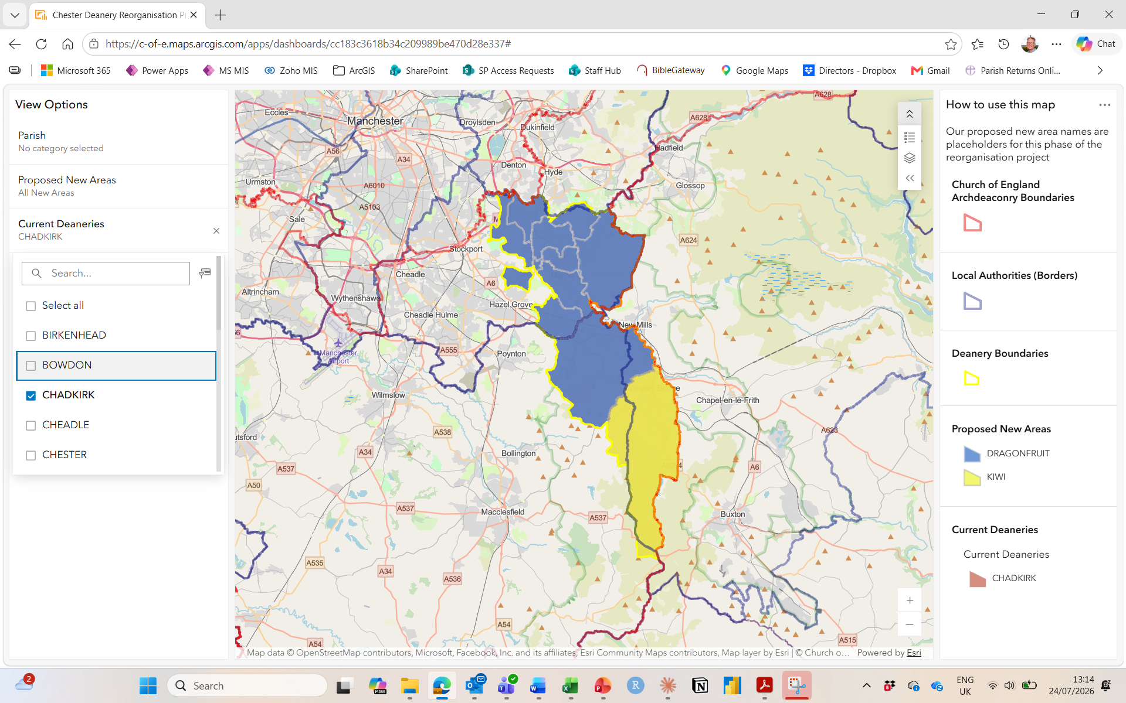
CHADKIRK:
New Areas:
9 to DRAGONFRUIT
1 to KIWI
Click here to return to previous slide

Slide 32
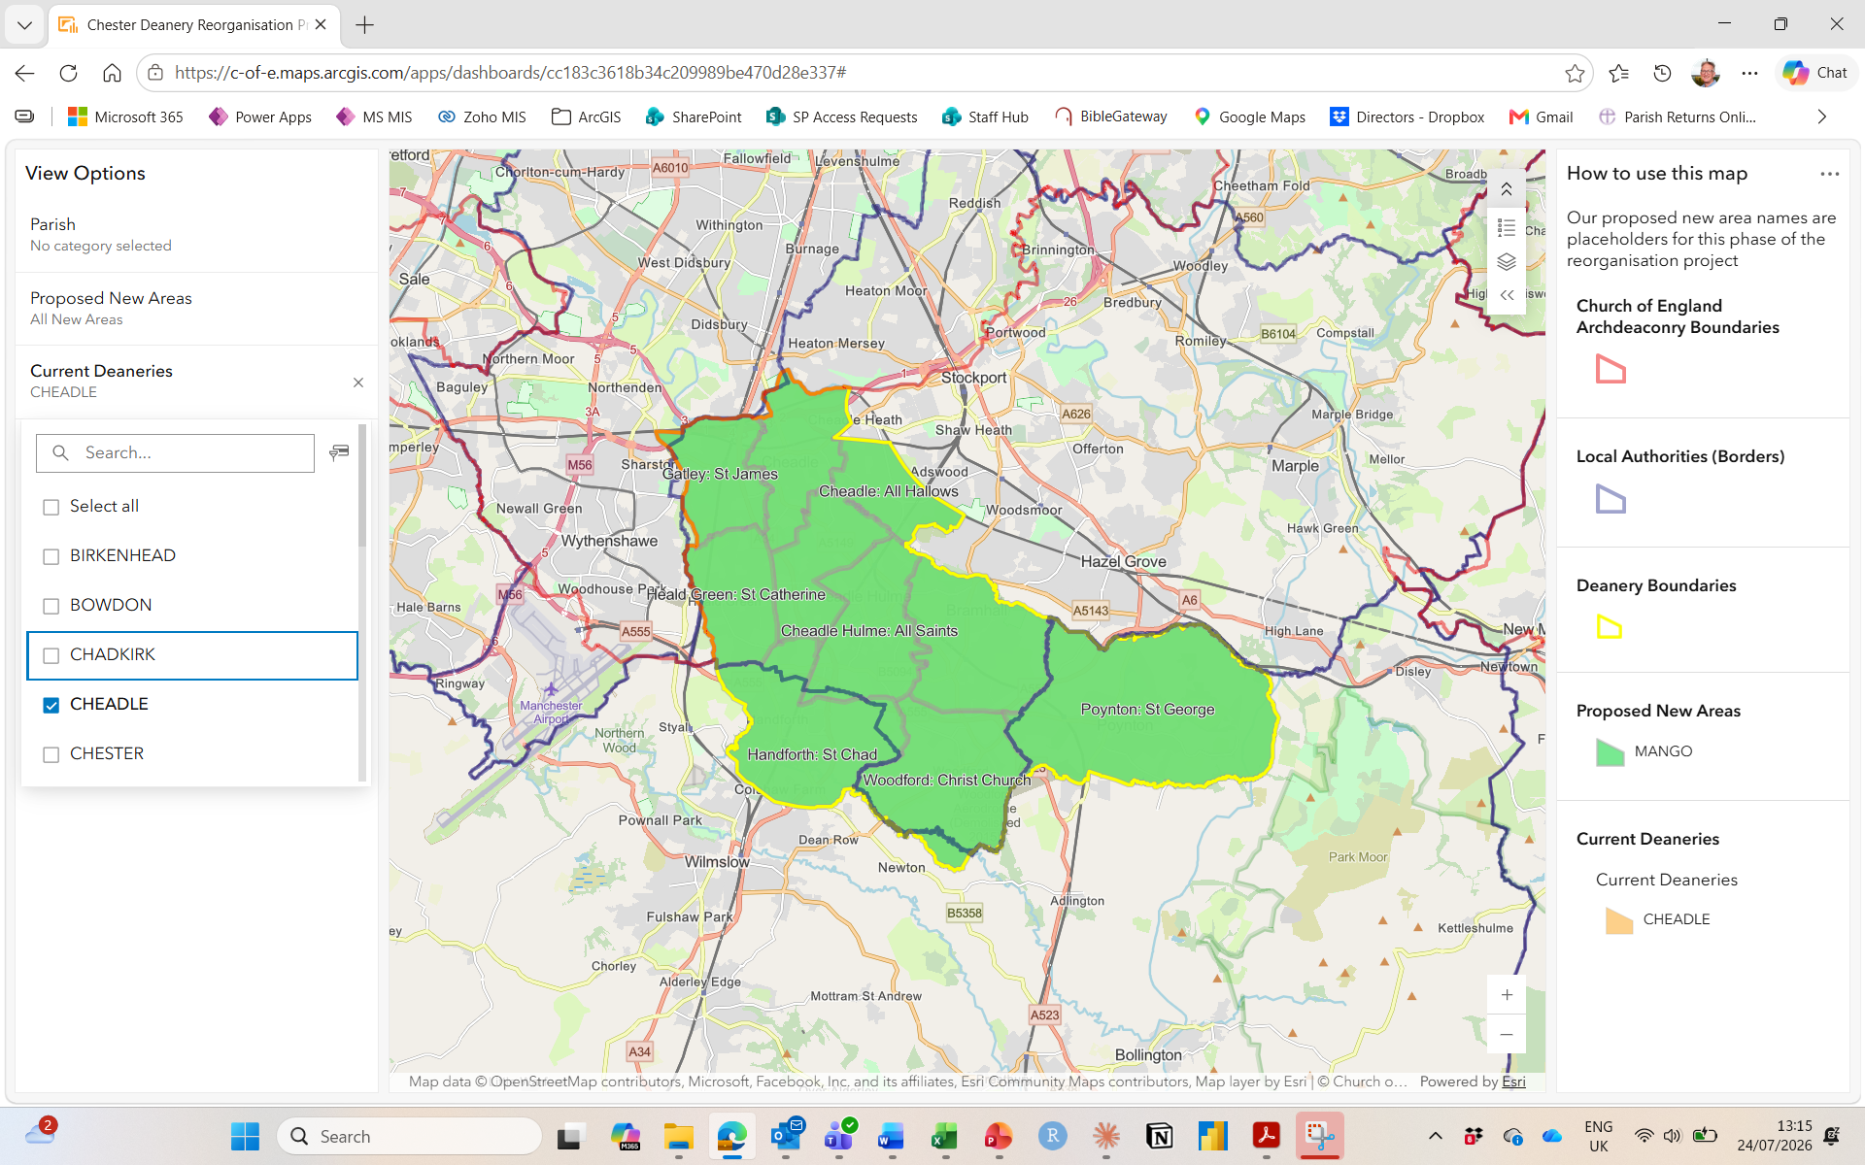
CHEADLE:
New Areas:
All to MANGO
Click here to return to previous slide

Slide 33
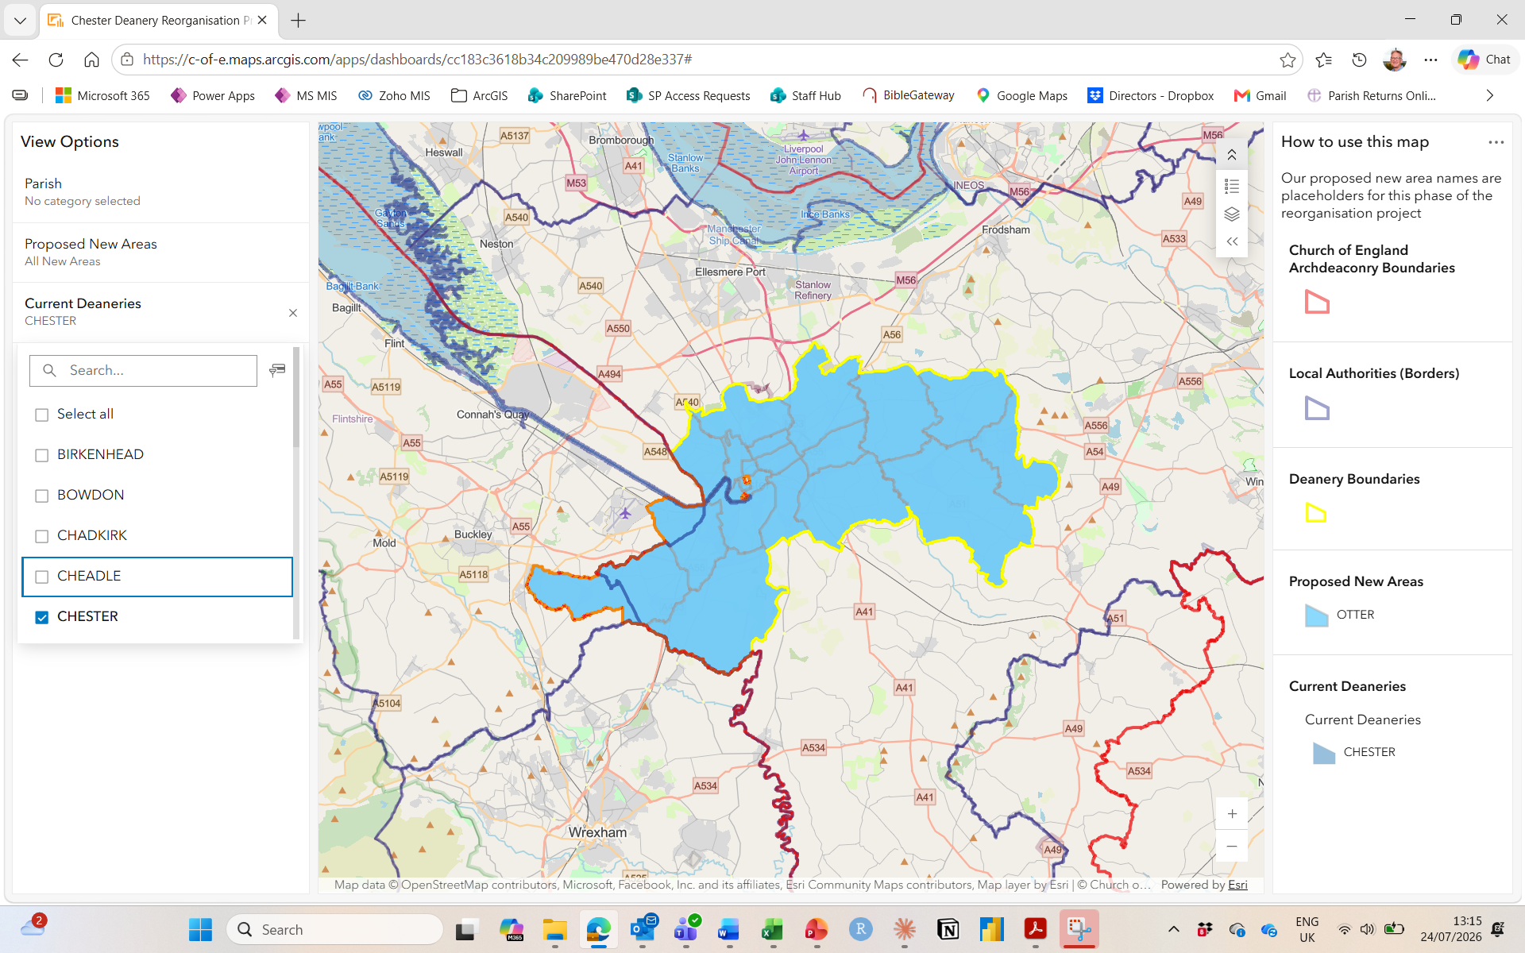
CHESTER:
New Areas:
All to OTTER
Click here to return to previous slide

Slide 34
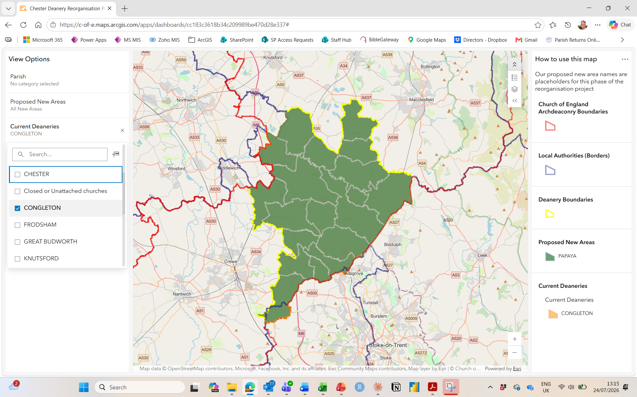
CONGLETON:
New Areas:
All to PAPAYA
Click here to return to previous slide

Slide 35
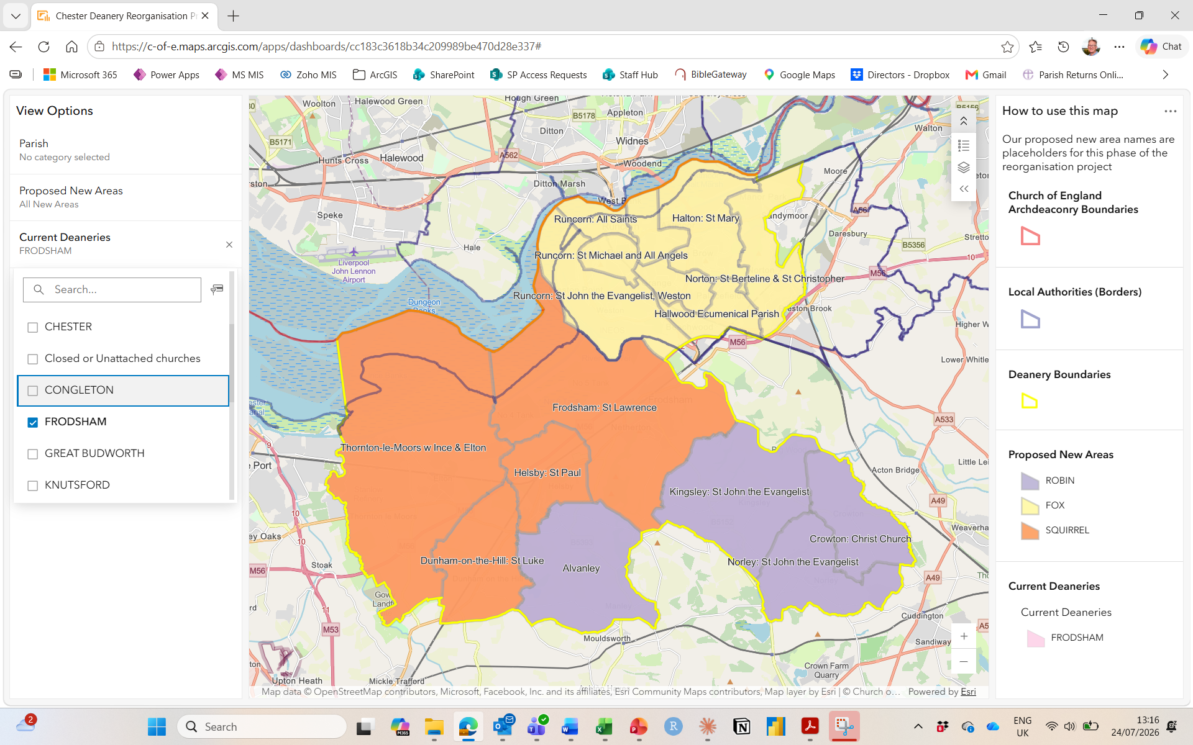
FRODSHAM
New Areas:
8 to FOX
4 to ROBIN
4 to SQUIRREL
Click here to return to previous slide

Slide 36
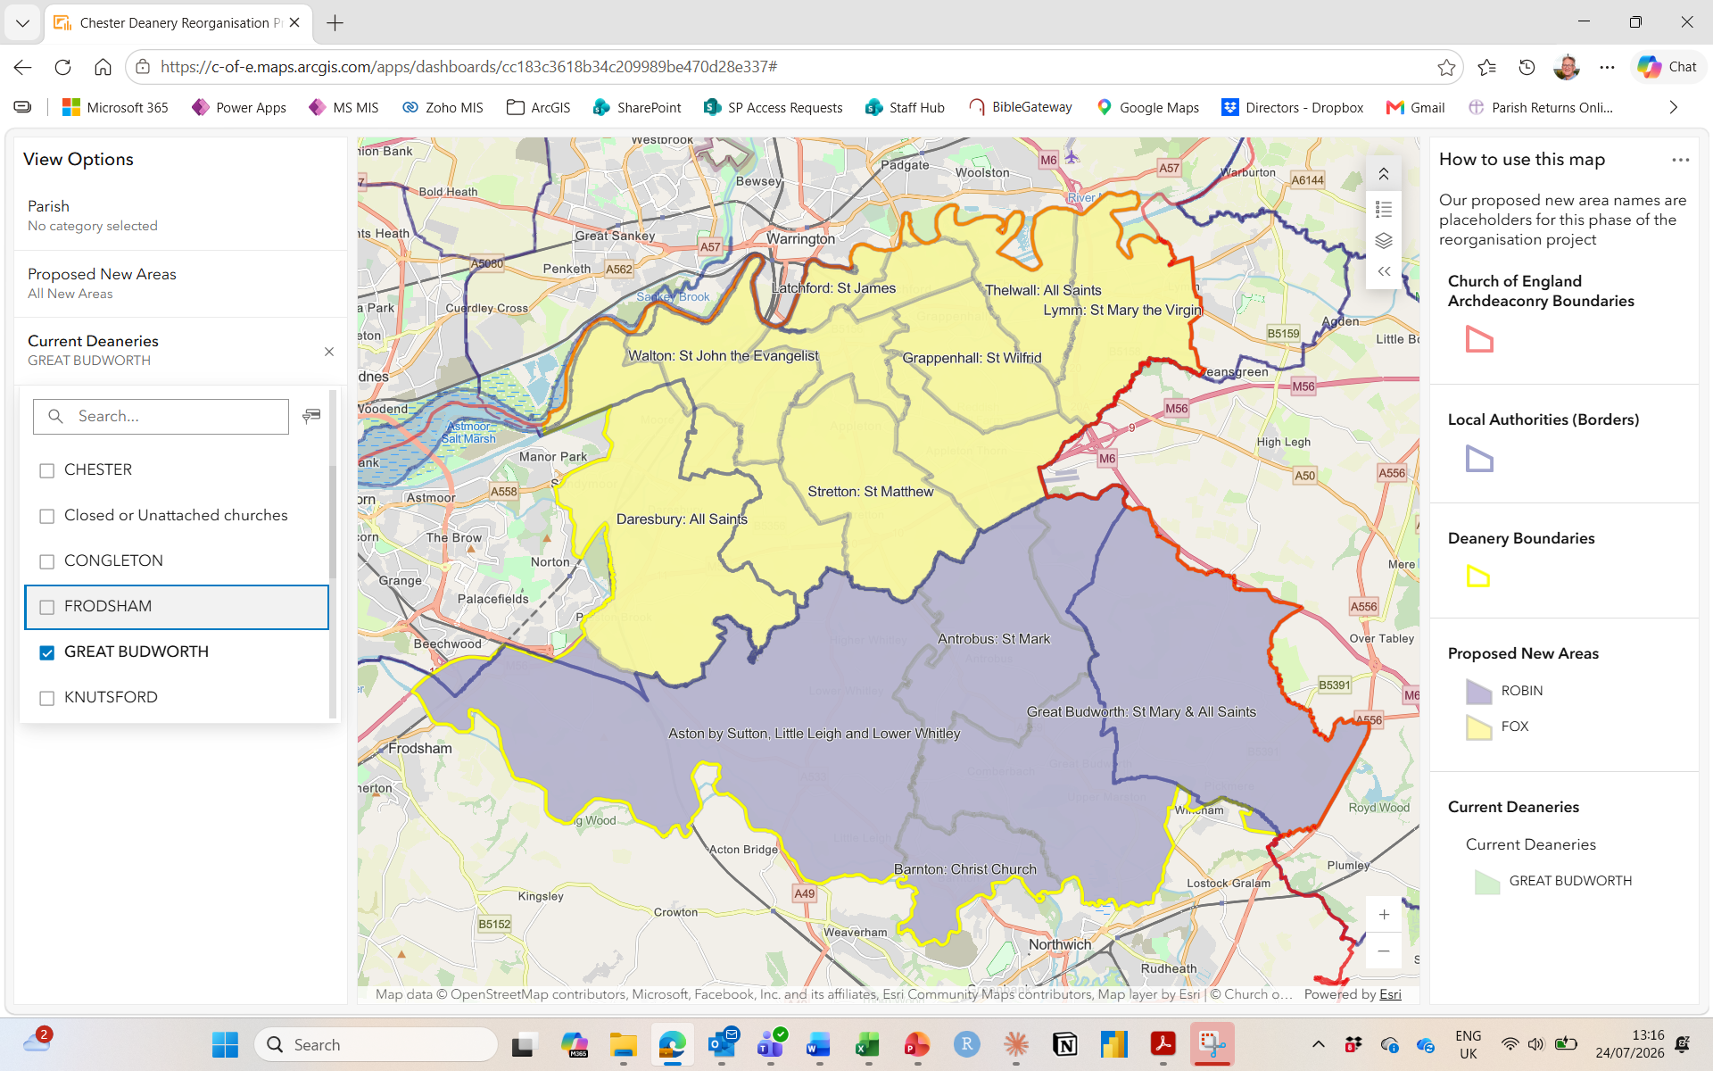
GREAT BUDWORTH:
New Areas:
10 to FOX
4 to ROBIN
Click here to return to previous slide

Slide 37
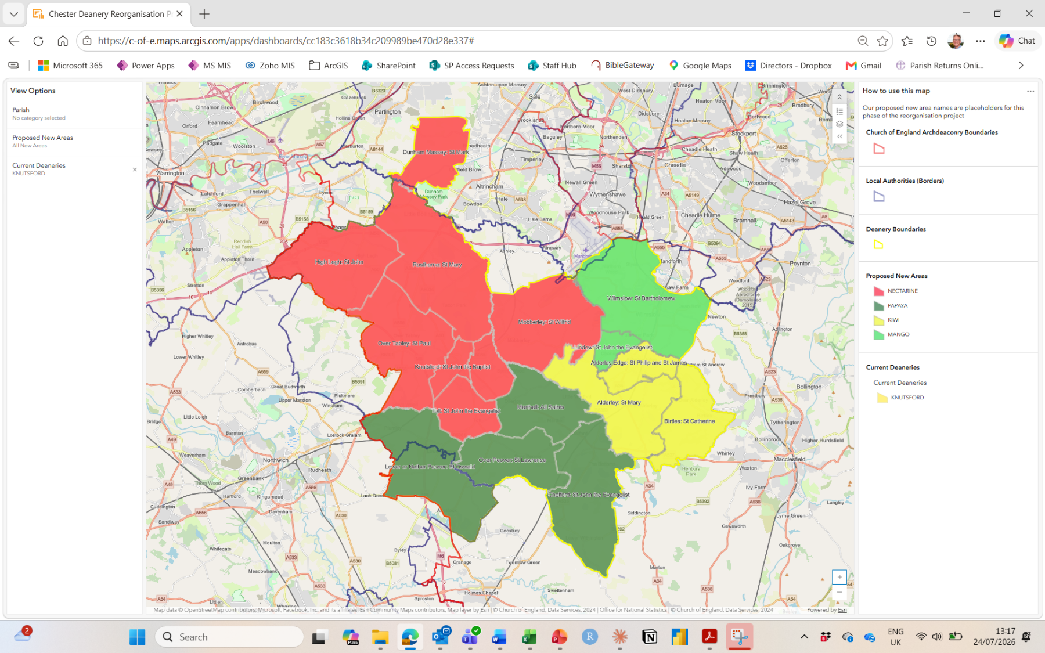
KNUTSFORD:
New Areas:
8 to NECTARINE
4 to PAPAYA
3 to KIWI
2 to MANGO
Click here to return to previous slide

Slide 38
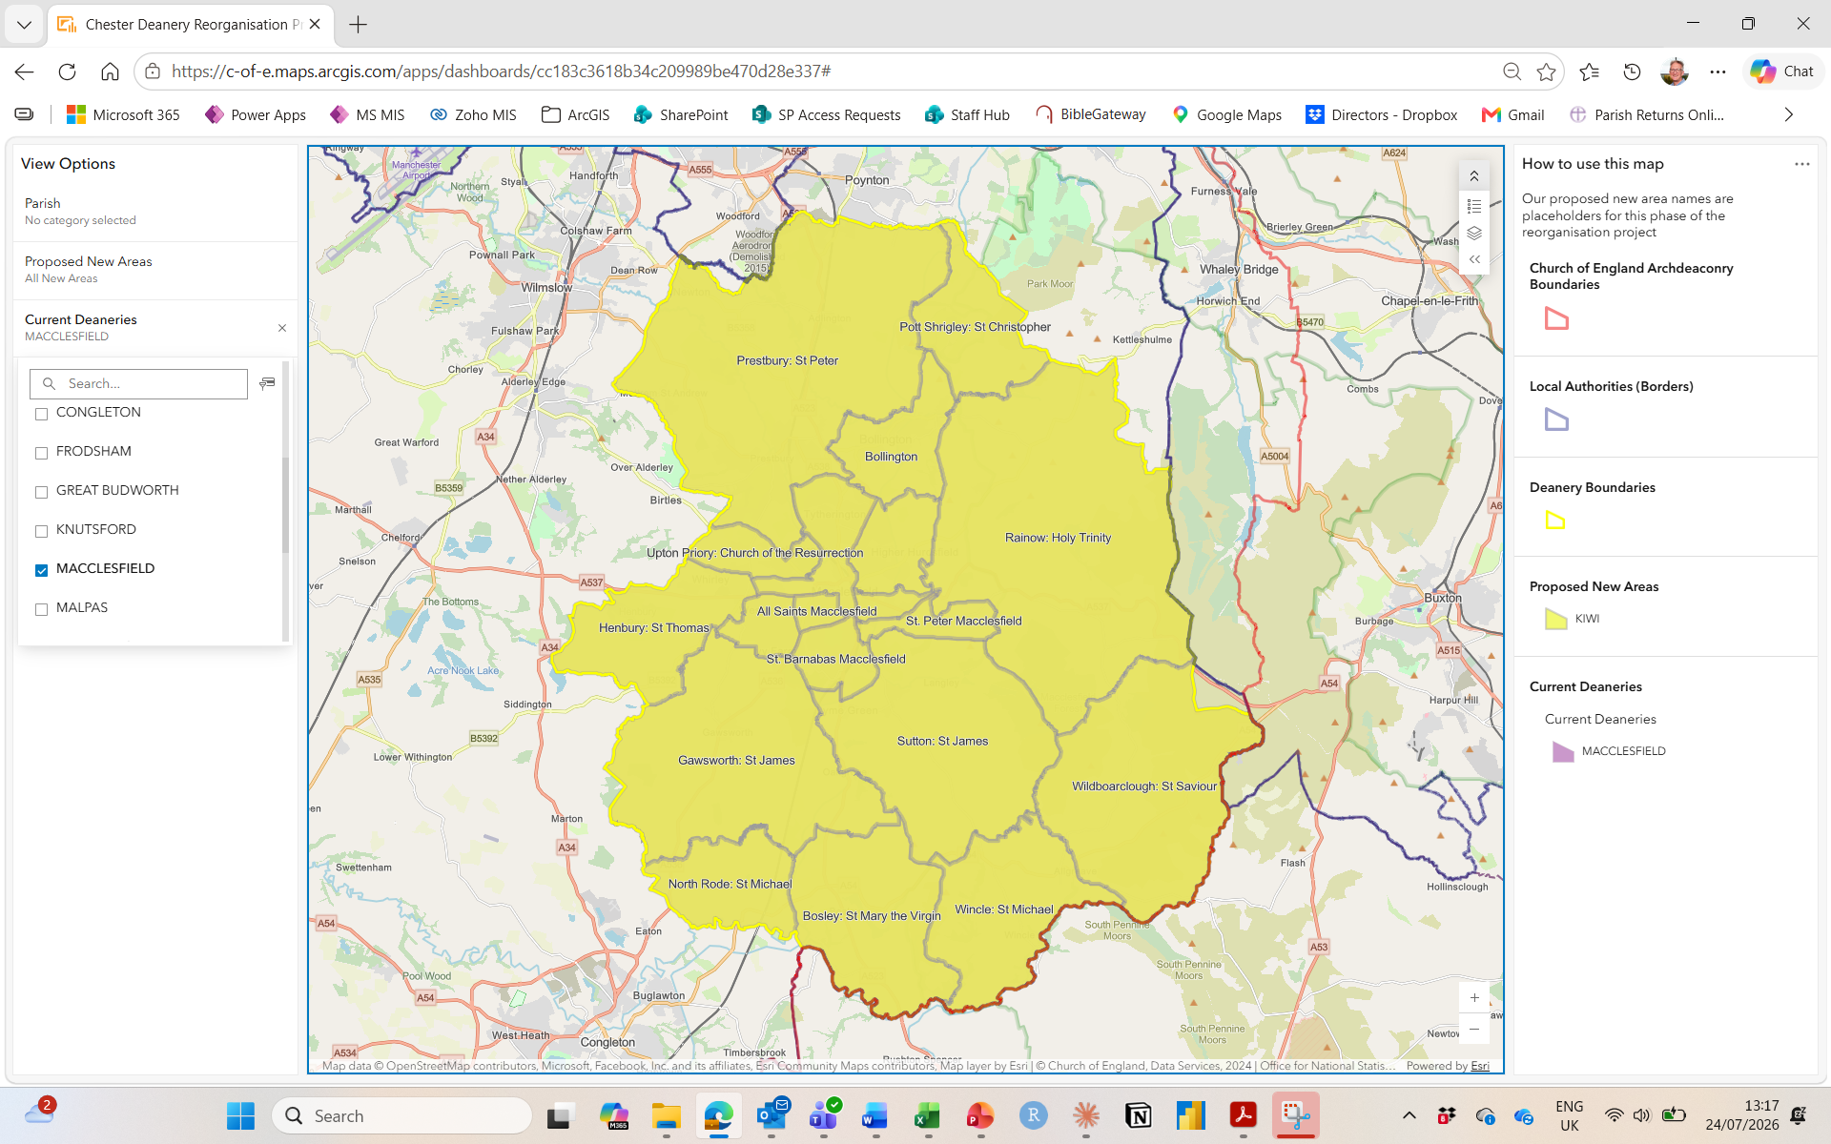
MACCLESFIELD:
New Areas:
All to KIWI
Click here to return to previous slide

Slide 39
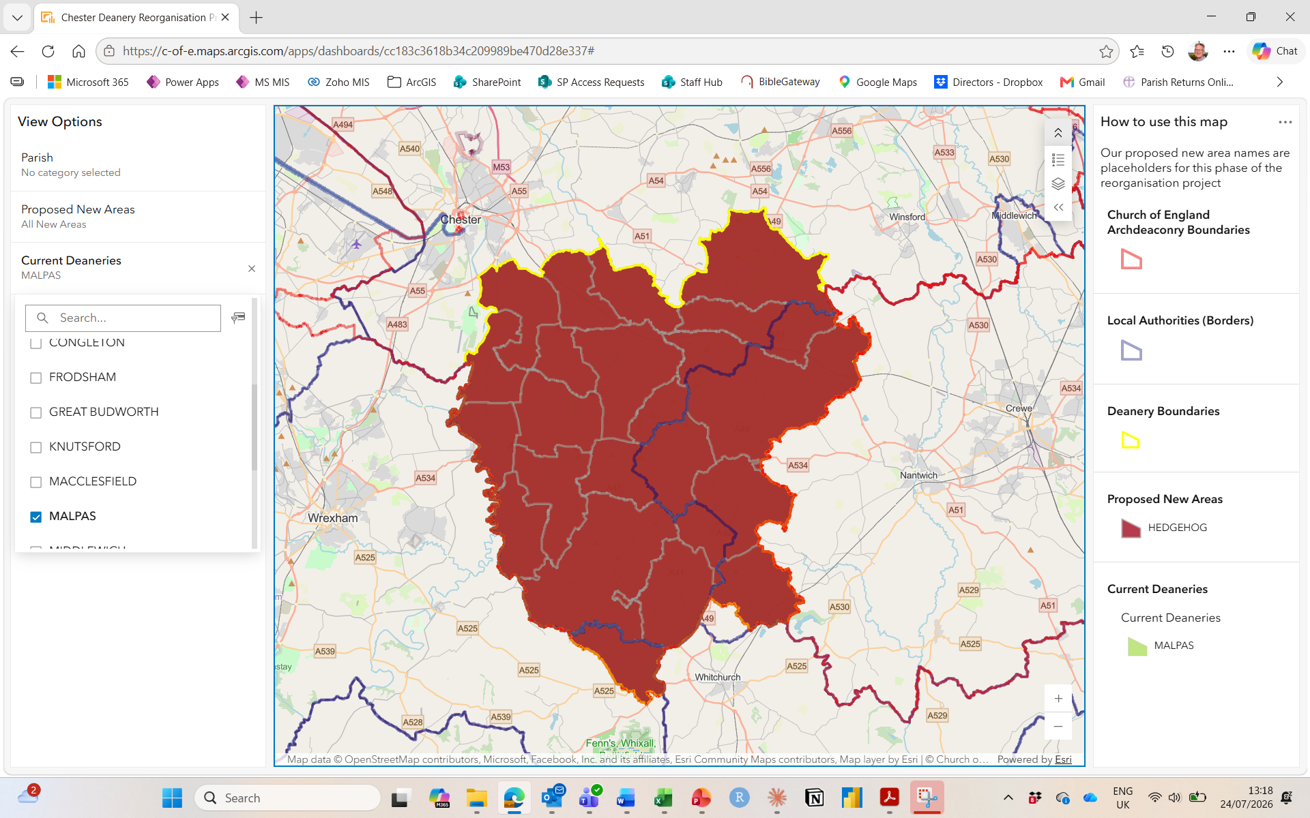
MALPAS:
New Areas:
All to HEDGEHOG
Click here to return to previous slide

Slide 40
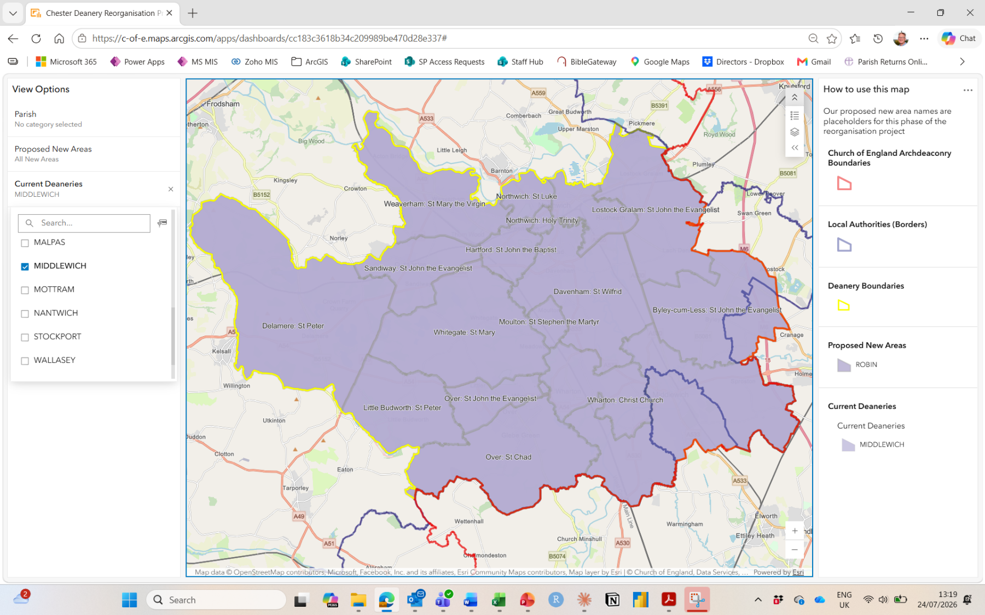
MIDDLEWICH:
New Areas:
All to ROBIN
Click here to return to previous slide

Slide 41
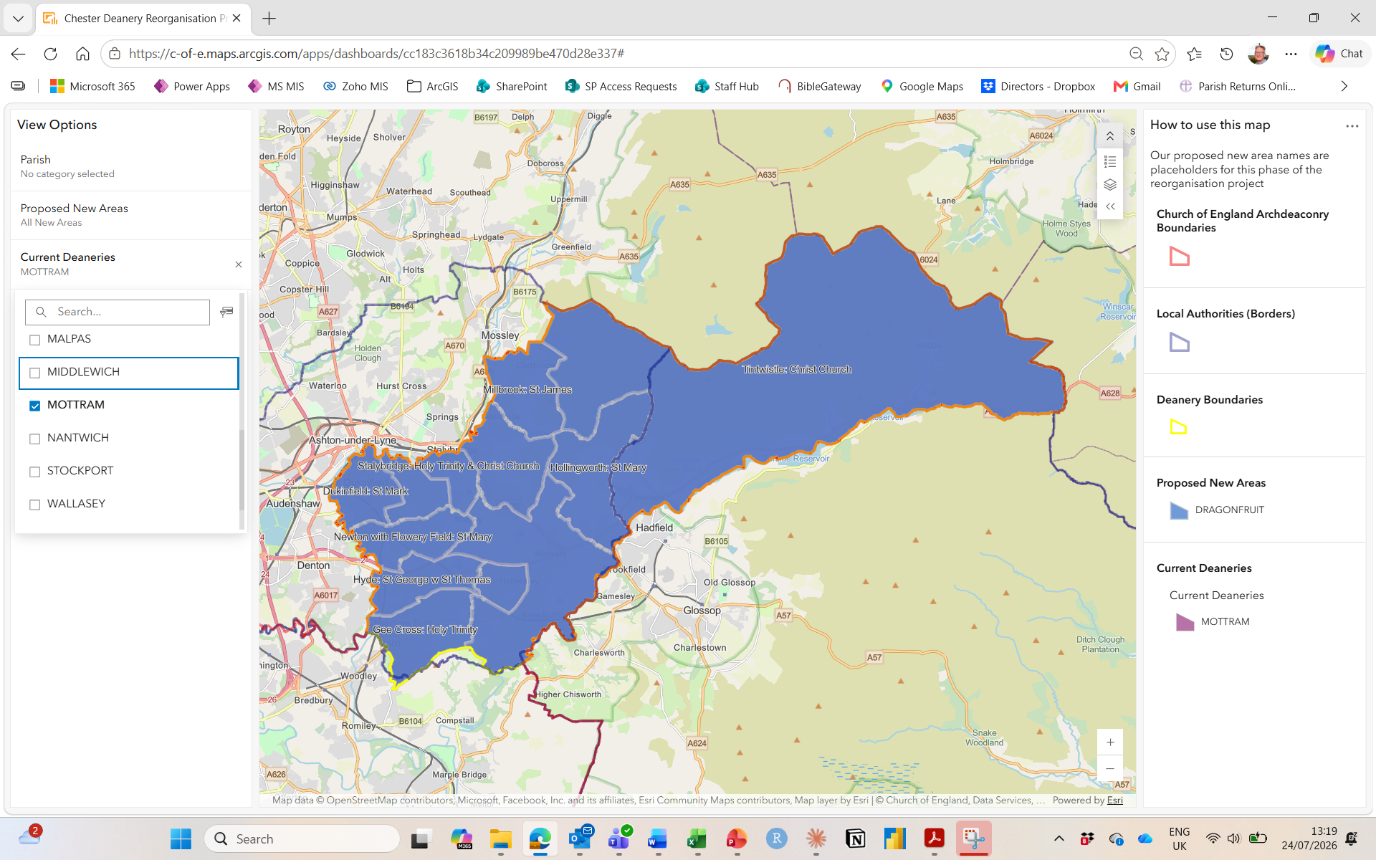
MOTTRAM:
New Areas:
All to DRAGONFRUIT
Click here to return to previous slide

Slide 42
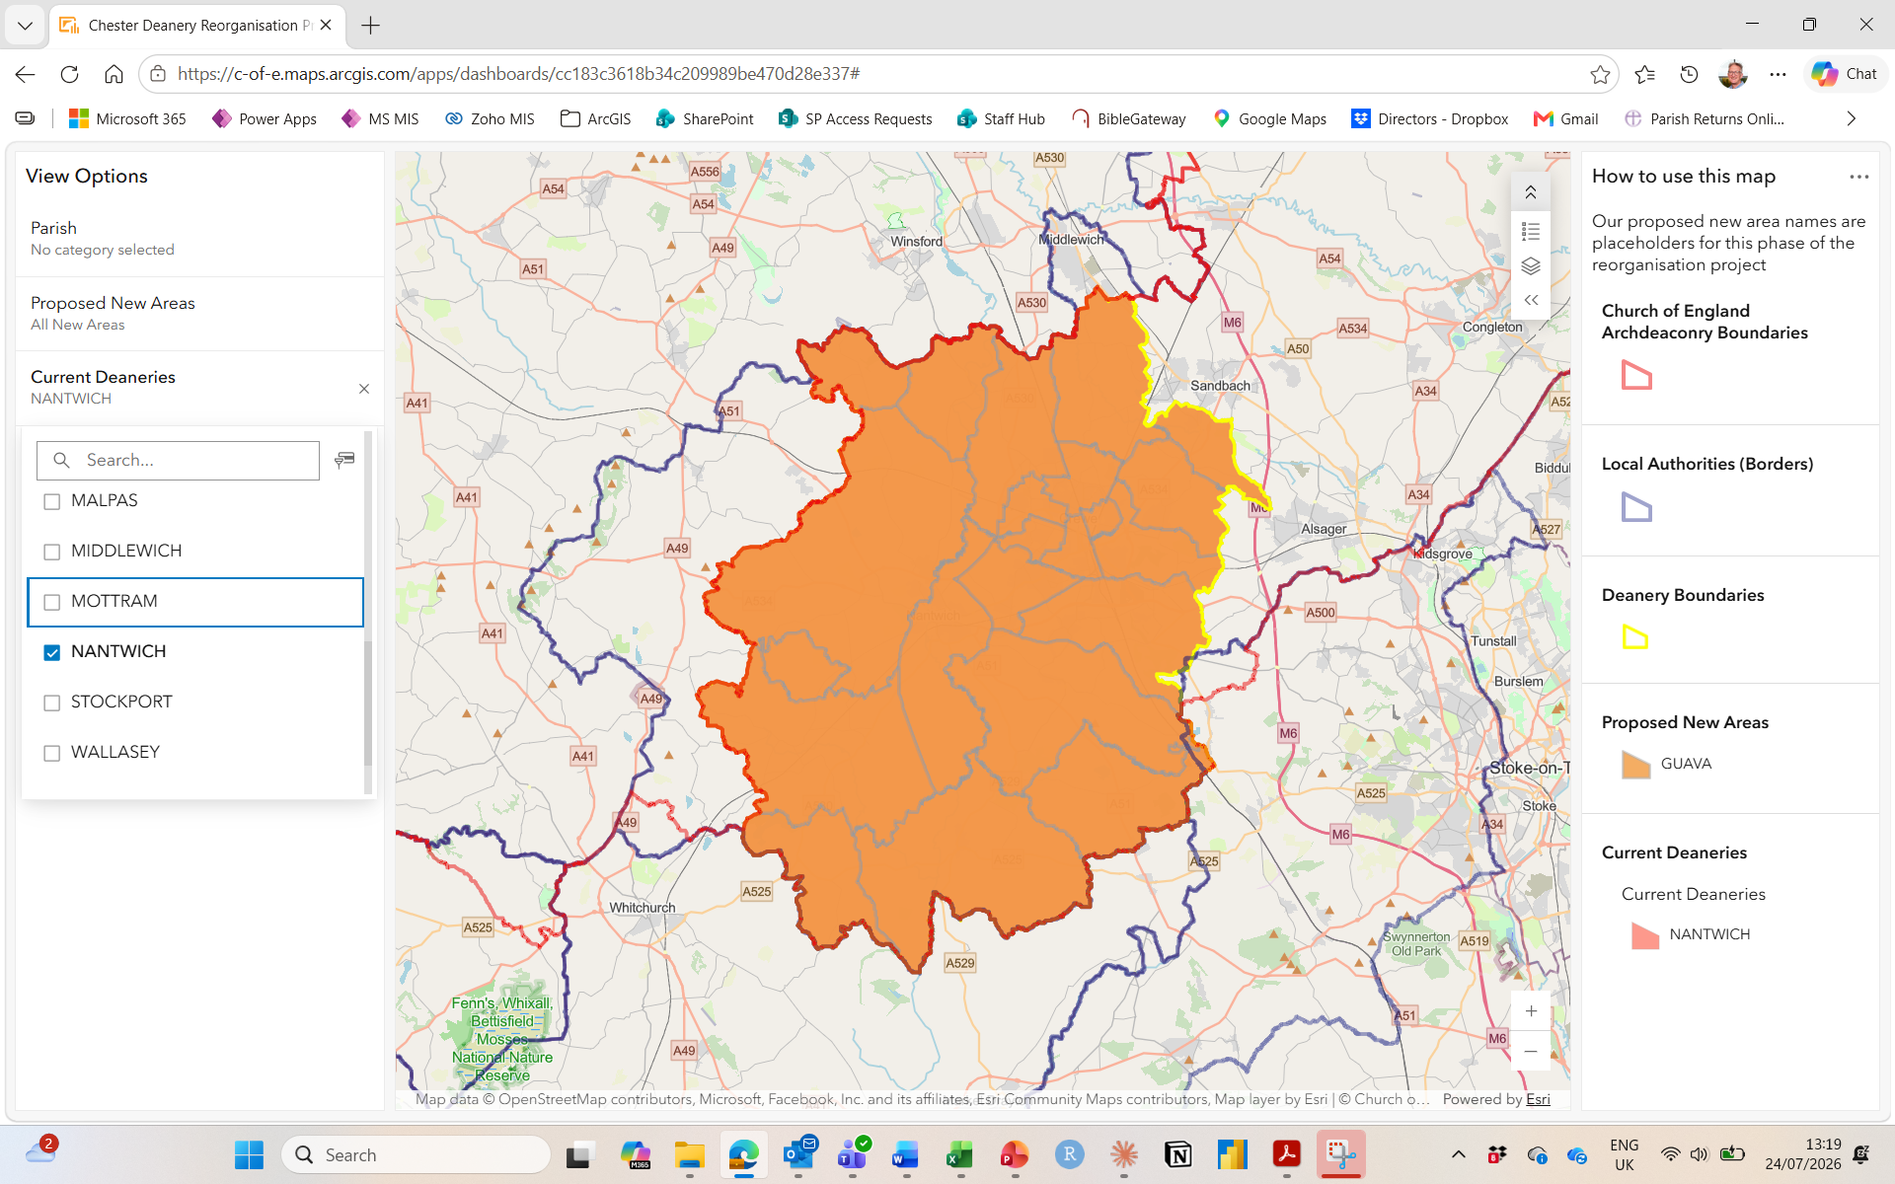
NANTWICH:
New Areas:
All to GUAVA
Click here to return to previous slide

Slide 43
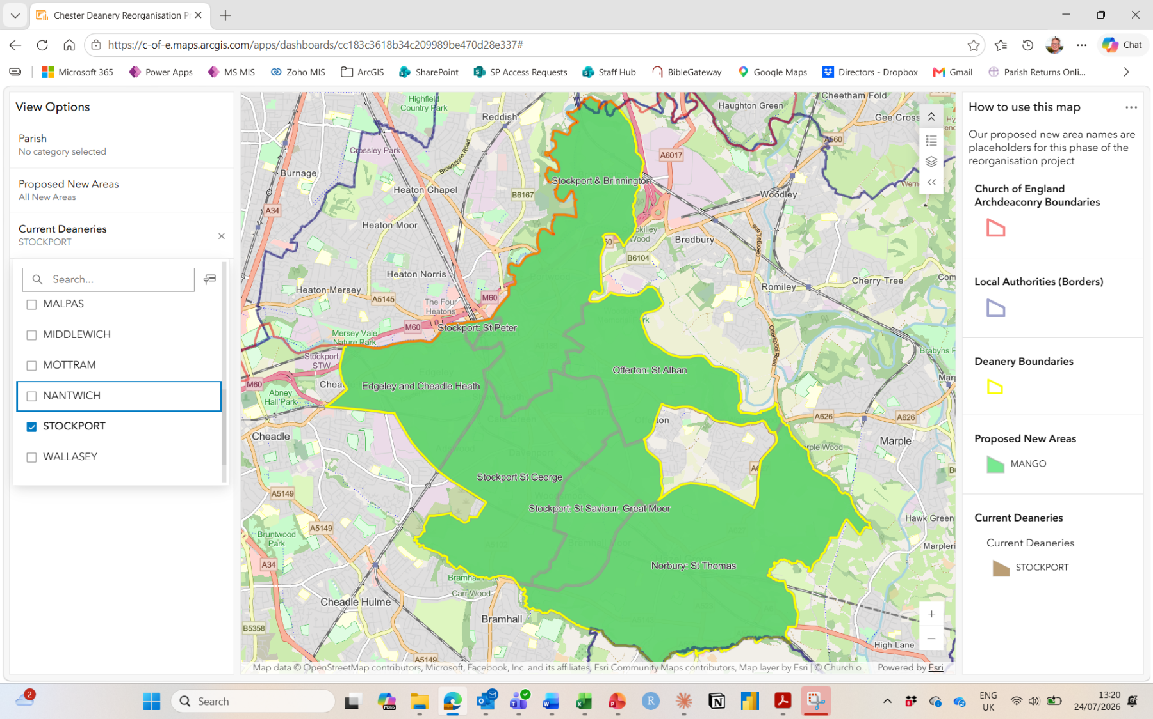
STOCKPORT:
New Areas:
All to MANGO
Click here to return to previous slide

Slide 44
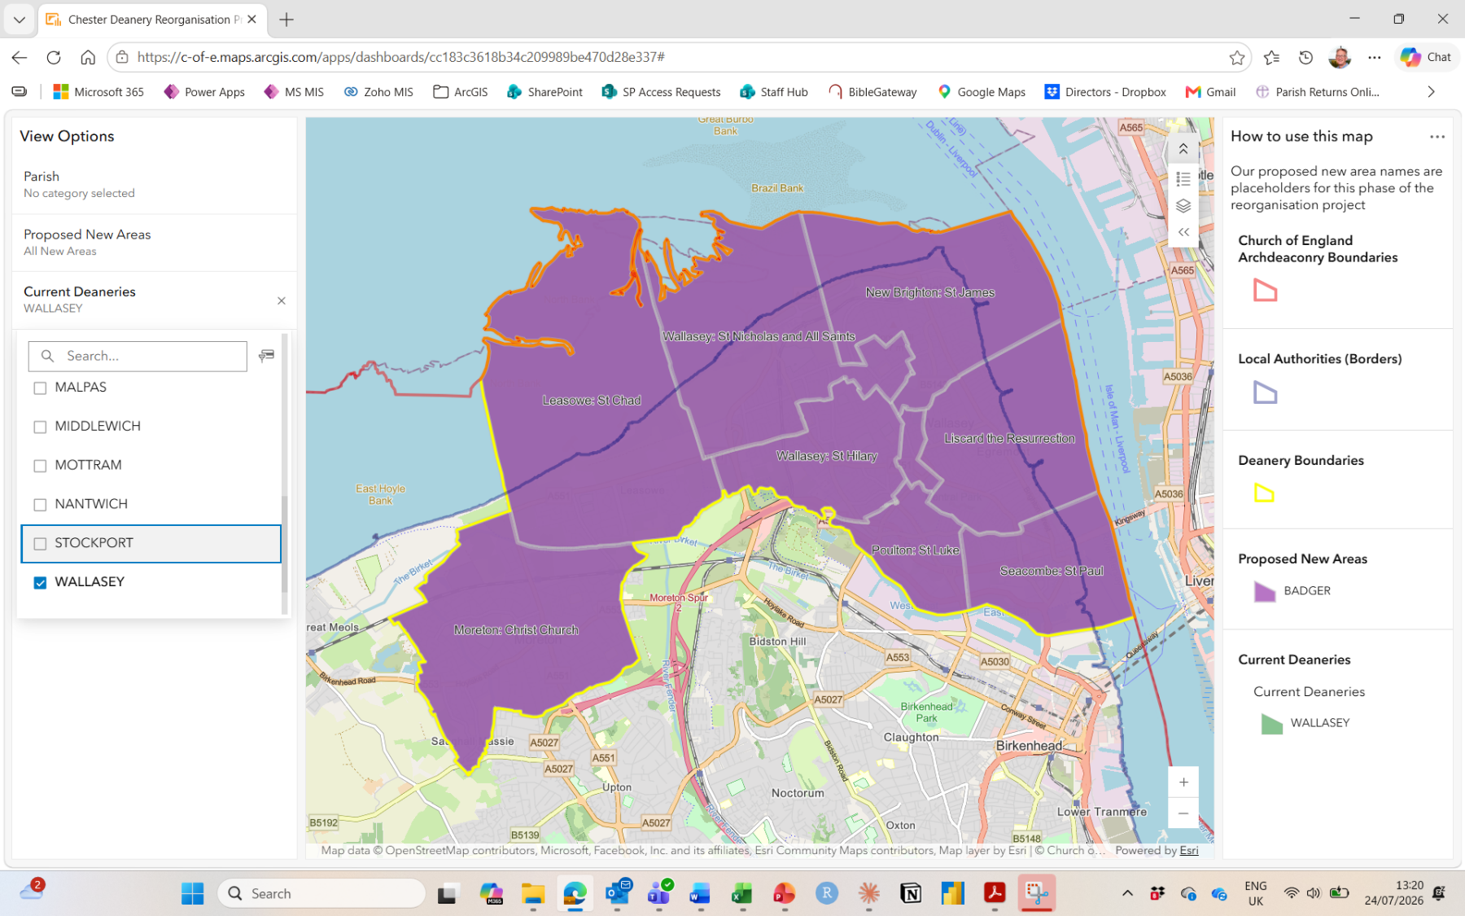
WALLASEY:
New Areas:
All to BADGER
Click here to return to previous slide

Slide 45
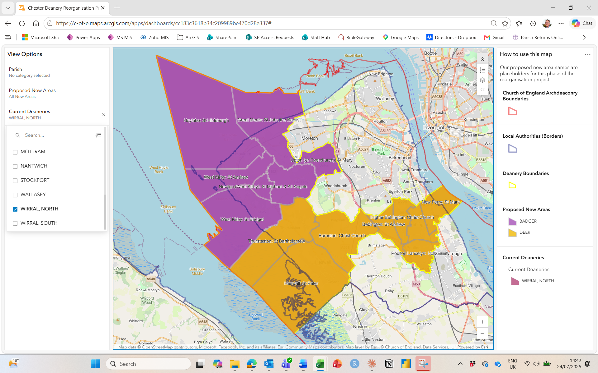
WIRRAL NORTH:
New Areas:
7 to DEER
7 to BADGER
Click here to return to previous slide

Slide 46
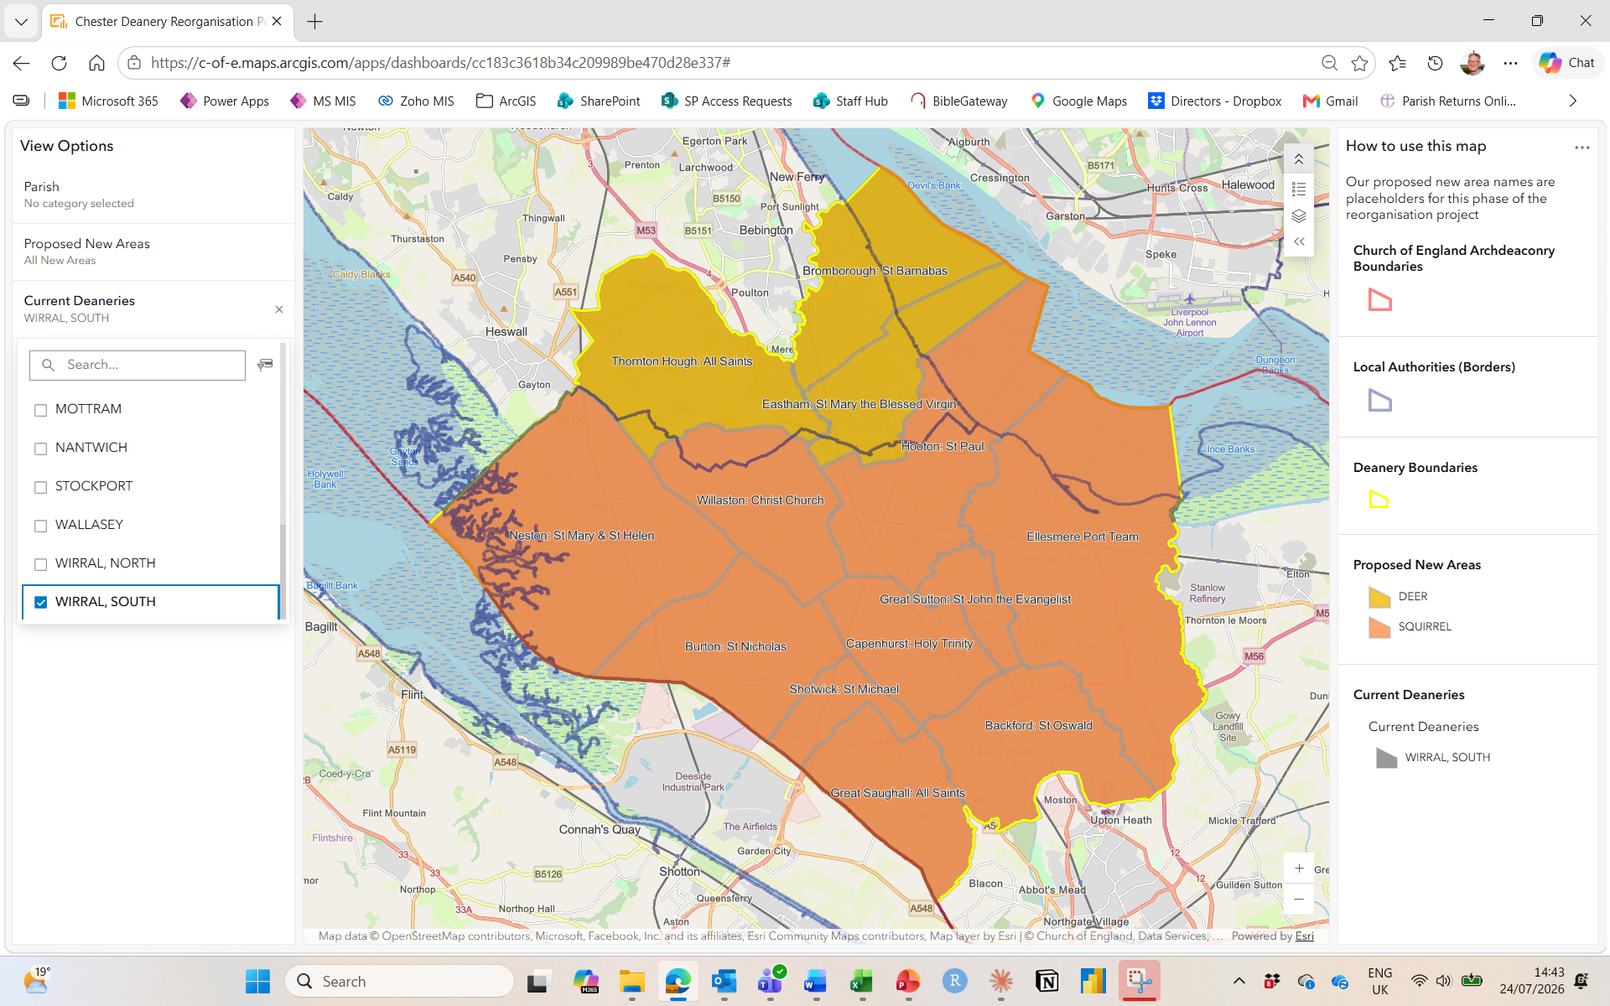
WIRRAL SOUTH:
New Areas:
10 to SQUIRREL
3 to DEER
Click here to return to previous slide

